Slide 1




Handwashing Action Detection System for an Autonomous Social Robot
Sreejith Sasidharan, Pranav Prabha, Devasena Pasupuleti, Anand M Das, Anand M Das, Chaitanya Kapoor, Gayathri Manikutty, Praveen Pankajakshan, and Bhavani Rao
AMMACHI Labs, Amrita Vishwa Vidyapeetham, India

Slide 2
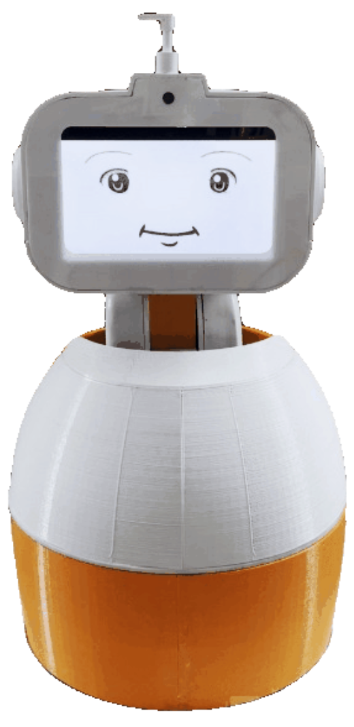
Introduction
Poor hand hygiene practices among children have been identified as the primary cause of morbidity such as anaemia, respiratory illnesses, and diarrhoea.
However, most handwashing campaigns conducted over the past three decades failed to establish handwashing behaviour as a regular habit.✝
An autonomous social agent that observes children while handwashing and encourages good hand washing practices could provide an opportunity for handwashing behavior to become a habit
Prior studies showed that the intervention of a social robot can significantly improve the frequency and quality of hand washing among children.*
✝Hussam, R., Rabbani, A., Reggiani, G., Rigol, N.: Habit formation and rational addiction: A field experiment in handwashing. SSRN Electronic Journal (2017). https://doi.org/10.2139/ssrn.3040729
*A. Deshmukh, S. K. Babu, U. R, S. Ramesh, P. Anitha, and R. R. Bhavani, “Influencing hand-washing behaviour with a social robot: Hri study with school children in rural india,” in 2019 28th IEEE International Conference on Robot and Human Interactive Communication (RO-MAN), 2019, pp. 1–6.
Notes:
Poor hand hygiene practices among children have been identified as the primary cause of morbidity such as anaemia, respiratory illnesses, and diarrhoea. Widespread adoption of a proper handwashing routine with soap can potentially prevent up to one million deaths worldwide. It can lower the risk of respiratory infections by 16%. When hand hygiene is practised in community school settings, research has shown that it has reduced absenteeism due to gastrointestinal illness.
However, despite its simplicity and effectiveness, most handwashing campaigns conducted over the past three decades failed to establish handwashing behaviour as a regular habit. Handwashing behaviour can become effective only if it is practised often enough, and for this, it must become a habit. We believe that when handwashing regimens are introduced to children at a young age, it has the potential to instil regular habits.
An autonomous social agent that observes children while handwashing and encourages good hand washing practices could provide an opportunity for handwashing behavior to become a habit.
Prior studies showed that the intervention of a social robot (Pepe) can significantly improve the frequency and quality of hand washing among children.
Importance of hand hygiene in healthcare.

Slide 3
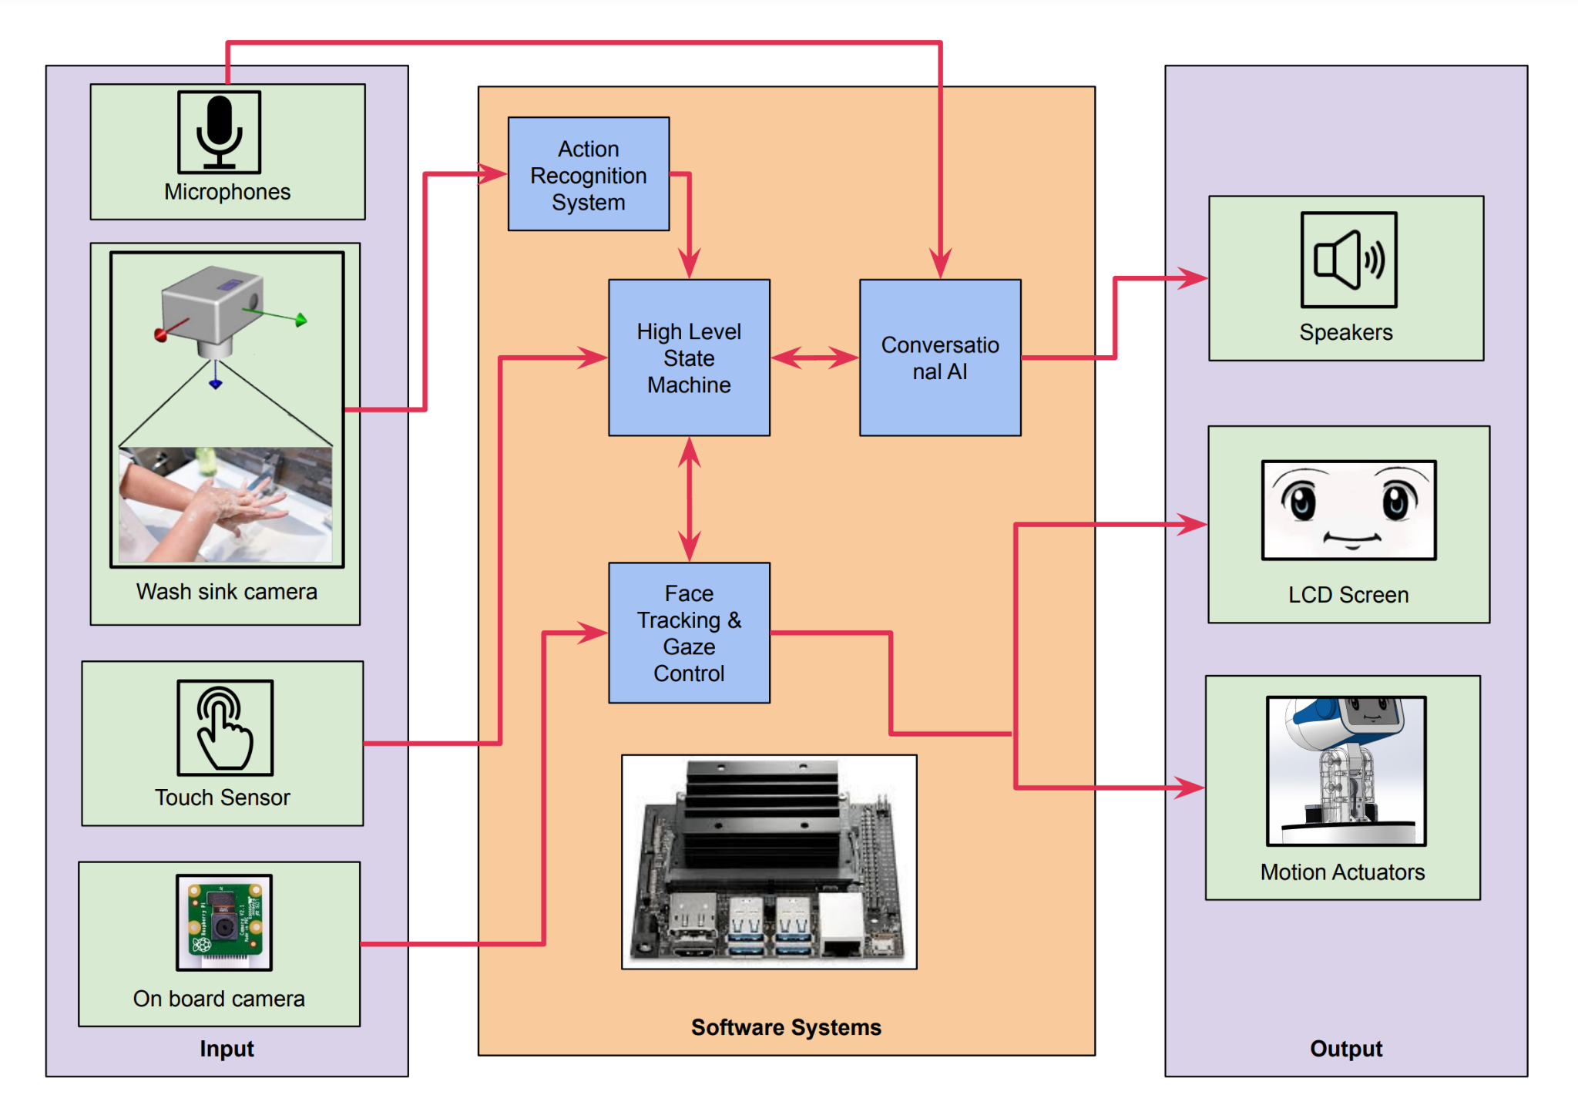
Social Robot Architecture with Integrated Action Recognition
Notes:
A critical element of such a robot is its action detection system which classifies the handwashing steps.
We present an AI model that can detect the different hand washing steps and classify it accurately in order to monitor the quality of hand washing.
We have focused our work on the six main steps of hand hygiene which are common to both hand washing with soap and hand rubbing with alcohol-based formulation, as prescribed by the WHO guidelines.

Slide 4
Prior Literature
Convolutional neural networks (CNN) can be used for classification of actions (Handwashing steps in our case) when the data is diverse and rich.
Cikel et al.✝ conducted a study focusing on the classification of hand washing steps using ResNet-152 with LSTMs.
Chen et al.* studied the effectiveness of the Spatial and Channel-wise Attention in Convolutional Neural Network (SCA-CNN) framework for image captioning.
Google’s Mediapipe Tracking the hands using landmarks
S. Zhang, Z. Wei, J. Nie, L. Huang, S. Wang, and Z. Li, “A review on human activity recognition using vision-based method,” Journal of healthcare engineering, vol. 2017, 2017.
✝K. Cikel, M. Arzamendia Lopez, D. Gregor, D. Gutiérrez, and S. Toral, “Evaluation of a cnn+lstm system for the classification of hand-washing steps,” 06 2021.
*L. Chen, H. Zhang, J. Xiao, L. Nie, J. Shao, W. Liu, and T.-S. Chua, “Sca-cnn: Spatial and channel-wise attention in convolutional networks for image captioning,” in Proceedings of the IEEE conference on computer vision and pattern recognition, 2017, pp. 5659–5667.
Notes:
Convolutional neural networks (CNN) can be used for classification of actions (Handwashing steps in our case) when the data is diverse and rich. Each hand washing action from an input video stream is fed as a sequence of images to the CNN, thereby creating a frame-based image classifier.
Cikel and colleagues conducted a study focusing on the classification of hand washing steps using ResNet with LSTMs. Their model had an accuracy of 97.33%. Due to the large complexity of LSTM models, the inference stage of LSTM can require significant computing power and memory resources in order to keep up with a real-time workload.
Chen et al. studied the effectiveness of the Spatial and Channel-wise Attention in Convolutional Neural Network (SCA-CNN) framework for image captioning. CNN models VGG-19 and ResNet-152 were used for image encoding part. The results show that SCA-CNN makes the original CNN multi-layer feature maps adaptive to the context-specific channelwise attention and spatial attention at multiple layers.
Google’s mediapipe - Would not work with self occlusion - fails on skin-to-skin contact.

Slide 5
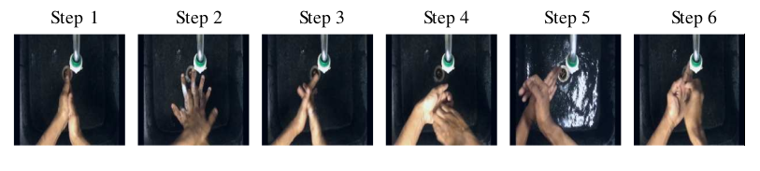
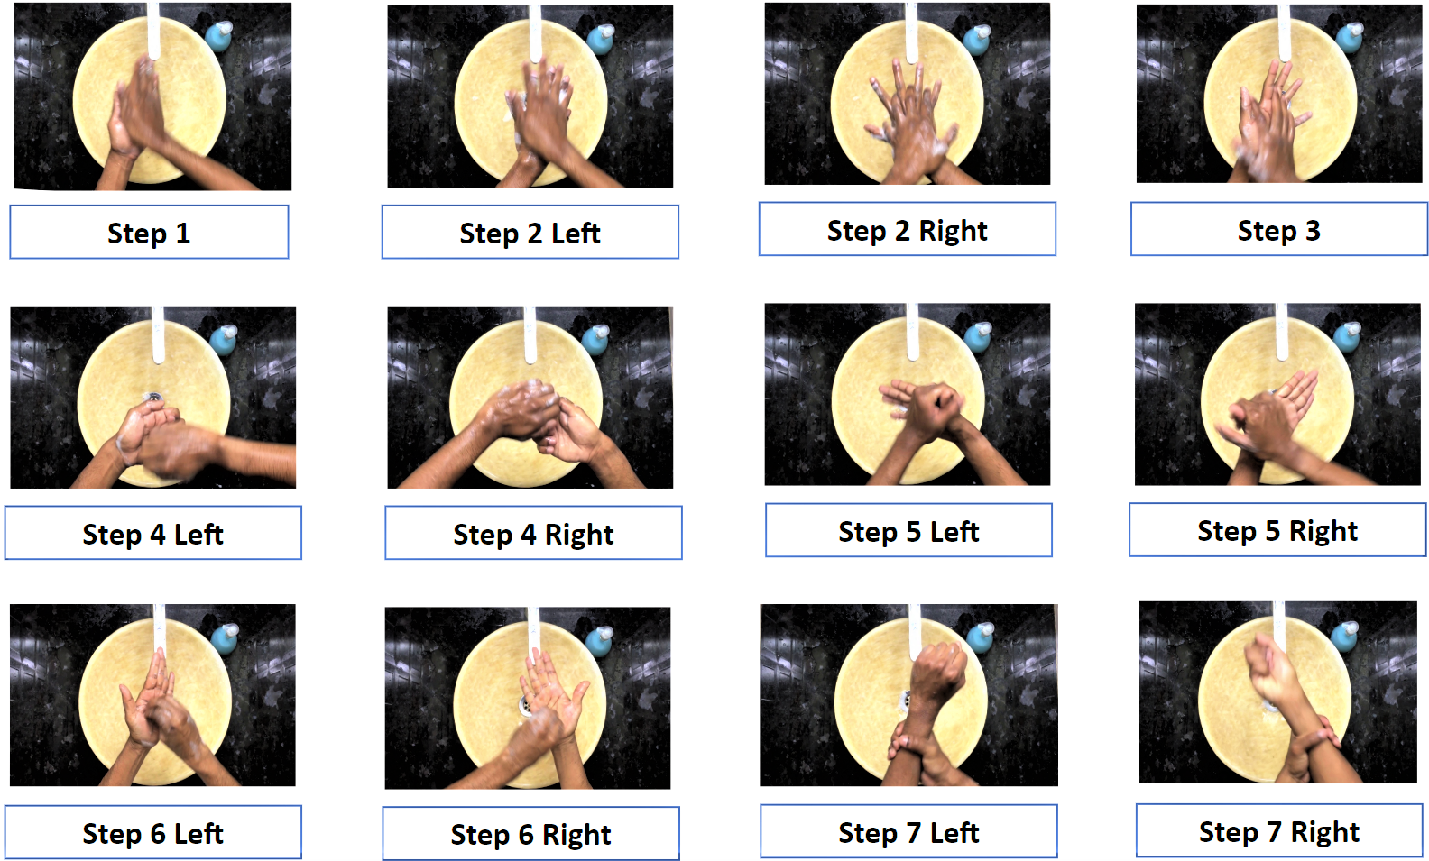
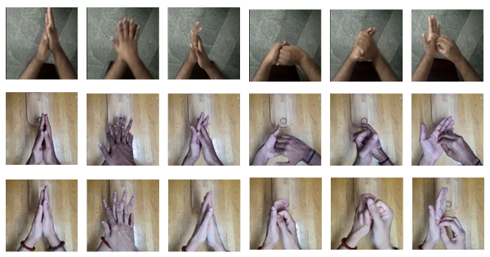
Dataset Overview-Open Source
Frames Dataset - 99545 Samples, 6 Classes
292 samples, 12 steps in handwashing
Unseen Test Dataset
“Sample: hand wash dataset.” [Online]. Available: https://github.com/Realtime-Action-Recognition/Realtime-Action-Recognition
Pranav et al., October 13, 2022, "Six steps of hand washing dataset with segmentation maps", IEEE Dataport, doi: https://dx.doi.org/10.21227/ghr9-y726.
Notes:
For our study, we chose an open-source dataset of WHO handwashing steps, which provides 292 samples for the 12 steps in the handwashing. This publicly available dataset is recorded against five different sink backgrounds.
For testing the performance and generalizability of the model, 3 custom datasets were also prepared.

Slide 6
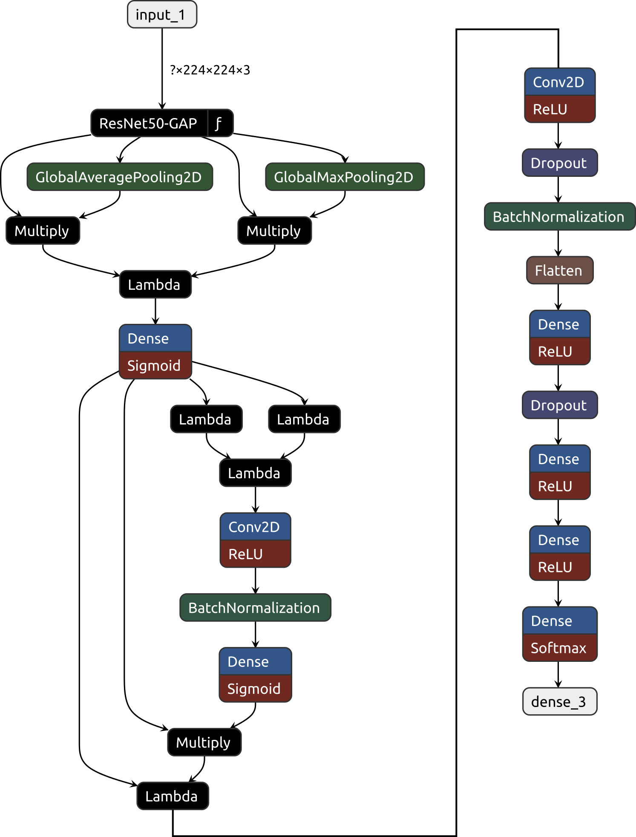
Model Architecture
? x 14 x 14 x 512
CNN (Resnet/VGG-16) + Attention Layers = Better Classification Accuracy
A Channel Spatial Attention Bilinear Pooling (CSAB) is implemented in the model.*
The models outputs into a fully connected, dropout, and a final dense layers with softmax activation.
Transfer learning leverages pre-trained models to reduce the training data required.
? x 7 x 7 x 512
? x 14 x 14 x 512
Spatial Attention
? x 512
? x 14 x 14 x 512
? x 25088
? x 256
? x 14 x 14 x 1
? x 14 x 14 x 512
? x 64
? x 14 x 14 x 512
Channel Attention
? x 6
Code Open Sourced at: https://github.com/voiD-96/HAR_Tencon2022
*W. Wang, J. Zhang, and F. Wang, “Attention bilinear pooling for fine-grained classification,” Symmetry, vol. 11, no. 8, 2019.
Notes:
The model uses both channel and spatial attention.
The GAP & GMP generates the masks - masks out the BG area.
That is why this arch can be generalized for
This is unsupervised - for reproducibility we have provided the code on github

Slide 7
Methodology
Before feeding into the neural network, the dataset underwent:
Data Preparation
Data Augmentation
The models were developed with Keras (> 2.4) built on top of Tensorflow 2.0 and was trained on a machine with an NVIDIA® Tesla P100 GPU.
After extensive hyperparameter tuning, the model was trained for 10 epochs each with a batch size of 128.
The backbone architectures that were used were ResNet−50 and VGG-16 for comparing the performance.
Notes:
We manually chose representational images that are visually similar to the six steps of handwashing prescribed by
the World Health Organisation. We also excluded images with severe motion blur and images without any hands in
the frame. The left-hand and right-hand versions of the handwashing steps two, four, five, and six were further
combined to form six classes in the dataset, representing the six steps of handwashing.
We further modified the dataset with an environment level train-test split to test the generalizability of the
trained model in unfamiliar environments. We did this by using four different background environments in the
dataset for training the model. The fifth environment, which the model did not see during training, was used for
testing the model’s performance.
Position Augmentation: Geometrical transformations can remove any positional bias of the hands. We
used random rotations, width shifts, random scaling, and horizontal flips to minimize positional biases.
Color Augmentation:The training image frames were augmented by adding spatial components and color
to the background. For color augmentation, we used a custom pre-process function, adding random contrast and
brightness values over 70% to 130% of the original pixel values of the image to image batches before training. This
simulated real-world change in the lighting conditions and the foreground object.
The epoch size was fixed as 10 because the model converges within 10 epochs of training.
Combine Methodology, data prep and aug

Slide 8
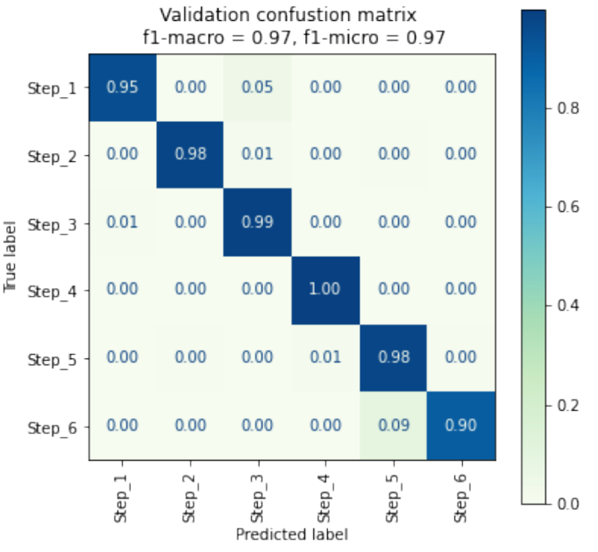
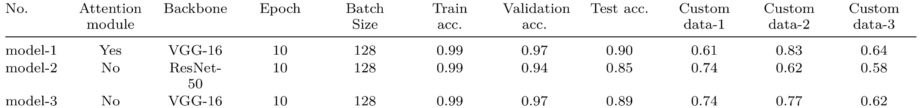
Results
As shown in table below, model 1 with attention layers had the highest accuracy and gave better predictions on custom datasets
All models exhibited very fast inference times of <5ms.
The model could effectively distinguish the different steps of hand washing.
Validation confusion matrix for VGG-16 model with Attention Layers

Slide 9
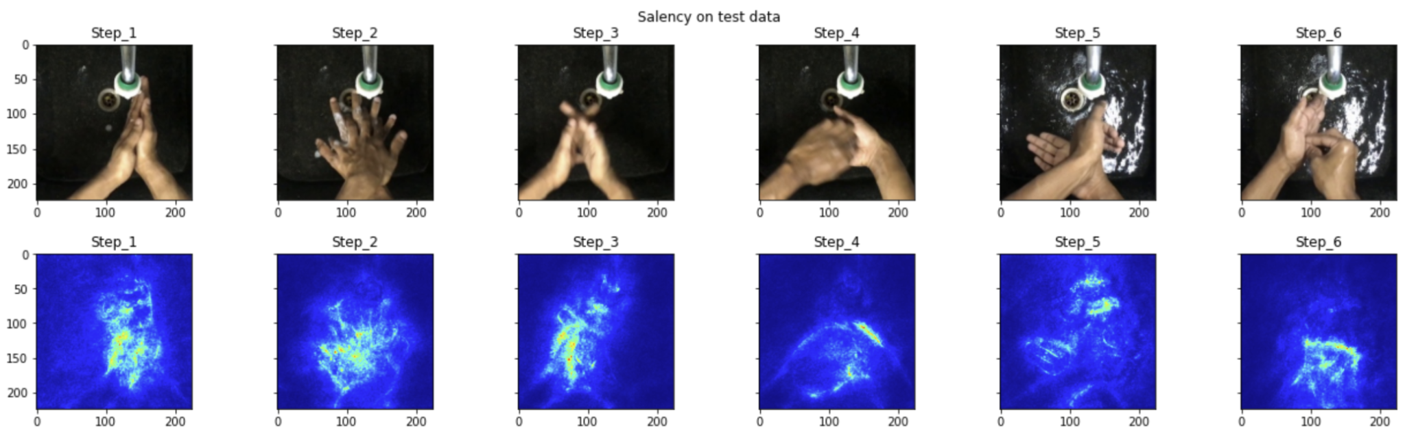
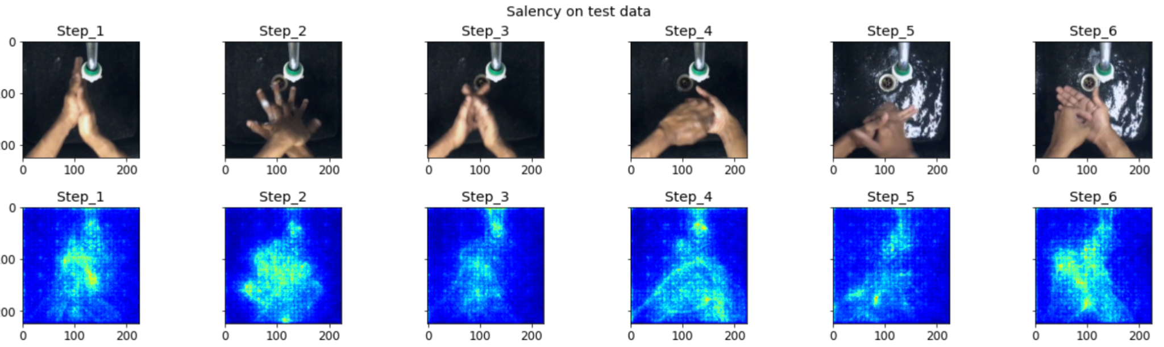
Results
Saliency map of model with attention layers
Saliency map of model without attention layers
Notes:
Here you can see the saliency map of model with attention layer and without attention layer. In the case with attention layer, the attention is on the hands and not on the background. This is not the case for plain model without attention. This as an important point that the VGG16 and Resnet alone were unable to make the distinction between the background and the hands. So it is less likely to generalize in other settings.
This is the most important finding that although accuracies for this dataset doesn't change much, but generalizability of such CNN models are questionable.

Slide 10
Conclusions and Future Work
The HAR model designed has established the feasibility of using deep neural networks in identifying hand washing steps with suﬀiciently good accuracies for practical real-world use in a hand washing social robot
Adding CSAB on top of the backbone VGG-16 model improves the classification accuracy to around 90%.
The model has good generalizability on the 3 unseen datasets with accuracies ranging between 60%-85%.
All the handwashing action in the training dataset is performed by the same person. There is a lack of variation on age group, gender, and ethnicity.
Enhancing the dataset used for training with less inter class similarities and hands of diverse people may further improve the generalizability of the model.
Considering the temporal information embedded in the dataset while training can also improve the performance of the model.
Notes:
We also added gaussian noise for generalizability.

Slide 11
Thank You

Slide 12
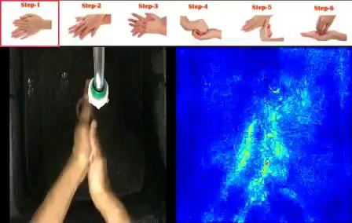
Results
Notes:
You can use this as an important point on mentioning that the VGG and other architectures aren't able to make the distinction between the background and the hands. So it is less likely to generalize in other settings.
Because we see that there are some taps visible in the saliency map for VGG and this is the most important finding that although accuracies for this dataset doesn't change much, but generalizeability of such CNN models are questionable.

Slide 13

Data Preparation
Frame 1
Six Data Classes
Frame 2
Video Data
Split the video into individual frames
Frame 3
Train Data
Test Data
Frame N
Extract individual frames
Arrange the frames into six classes
Environment based train-test split of the data
Prediction Output
Notes:
We manually chose representational images that are visually similar to the six steps of handwashing prescribed by
the World Health Organisation. We also excluded images with severe motion blur and images without any hands in
the frame. The left-hand and right-hand versions of the handwashing steps two, four, five, and six were further
combined to form six classes in the dataset, representing the six steps of handwashing.
We further modified the dataset with an environment level train-test split to test the generalizability of the
trained model in unfamiliar environments. We did this by using four different background environments in the
dataset for training the model. The fifth environment, which the model did not see during training, was used for
testing the model’s performance.

